Slide 1
CODES AND STANDARDS FOR BUILDING ENVELOPE BARRIERS AND FLASHINGS
Tom Butt, FAIA, LEED AP/BD+C
Interactive Resources
510/236-7435
Tom.butt@intres.com

Slide 2
LEARNING OBJECTIVES
Become familiar with code requirements for water resistive barriers, air barriers, vapor retarders and flexible flashings.
Learn what industry standards apply to water resistive barriers, air barriers, vapor retarders and flexible flashings.
Learn what information is available to assist in the selection of water resistive barriers, air barriers, vapor retarders and flexible flashings.

Slide 3
Selection Challenges
Reliable comparable performance data of some generic and proprietary products challenging
Performance objectives unclear to designers and builders
Inconsistent, confusing and incomplete code requirements
Improper reference to and use of standards by manufacturers in product literature
Overlapping requirements

Slide 4
TYPES OF BARRIERS
Water Resistive Barriers (WRB)
Air Barriers
Vapor Barriers (technically, Vapor Retarders)
Flexible Flashings

Slide 5
CODES vs. STANDARDS
Building Codes (The Law)
  Prescriptive requirements
  Referenced standards (ASTM, etc.)
  Alternative materials, design and methods - Acceptance Criteria (AC) and ICC-ES Evaluation Reports
Other Industry Standards (ASTM, AAMA, WDMA, CSA, NAFS, etc.)

Slide 6
DEFINITION - WATER-RESISTIVE BARRIER (WRB)
2012 IBC-IRC: A material behind an exterior wall covering that is intended to resist liquid water that has penetrated behind the exterior covering from further intruding into the exterior wall assembly
ASTM E 2556: a material that is intended to resist liquid water that has penetrated the cladding system.

Slide 7
REPRESENTATIVE TERMINOLOGY IN COMMON USE (OR MISUSE)
Building paper
Tarpaper
Felt
Asphalt felt
House wrap
Building wrap
Sheathing membrane
Underlay for wall
Underlayment
Weather resistant/resistive barrier
Water resistant/resistive barrier
Sheathing paper
Weather barrier
Vapor barrier
Water barrier
Moisture barrier

Slide 8
REPRESENTATIVE CODE TERMINOLOGY
Water resistive barrier (CBC IBC and IRC)
Wall Sheathing Paper and Sheathing, Membrane, Breather-Type (NBCC)
Underlay for wall (EU)

Slide 9
WRBs and DRAINAGE WALLS
Cladding provides substantial water barrier, but some water can be expected to penetrate through the cladding system
Typically includes a concealed water resistive barrier
Provides for dissipating water that circumvents cladding by:
  Drainage
  evaporation

Slide 10
EXAMPLES OF DRAINAGE WALLS
Masonry veneer (anchored)
Stucco/cement plaster (including adhered veneer)
Wood/wood shingles/wood composite siding
Fiber cement siding
Rainscreen systems
Some metal siding applications

Slide 11
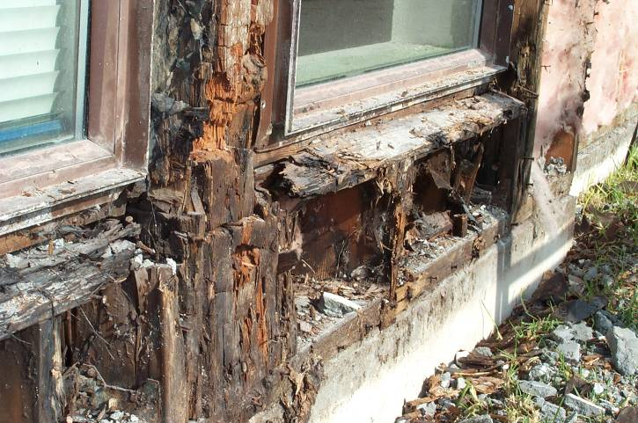
WHAT IS THE FUNCTION OF A WRB?

Slide 12
WATER RESISTANCE AND WATER VAPOR PERMEANCE
Liquid water resistance typically measured in units of pressure
US: lbf/in² (psi) or in-H²O
SI: Pa
Water Vapor Permeance typically measured in perms
US: 1 perm = grain/(ft²•h)(in Hg)
SI: 1 perm = 5.72 x 10-8 g/(s•m²).

Slide 13
WATER RESISTANCE TESTS
AATCC Test Method 127 (hydrostatic pressure test)
ASTM D779 (Currently withdrawn but being re-balloted as a vapor resistance standard) – Water Resistance of Paper, Paperboard and Other Sheet materials by the Dry Indicator Method (boat test)
CCMC Technical Guide for Sheathing, Membrane, Breather-Type, paragraph 6.4.5 (water ponding test)

Slide 14
ASTM D779 - BOAT TEST (WATER OR VAPOR?)
Water reacts with indicator dye on opposite side of sheet
Based on Federal Specification UU-P-31b (March 3, 1949) incorporated into UU-B-790a (February 5, 1968)
UBC Standard 14-1
ASTM D779 Test Method for Water Resistance of Paper, paperboard and Other Sheet Materials by the Dry Indicator Method

Slide 15
EXAMPLE OF BOAT TEST

Slide 16
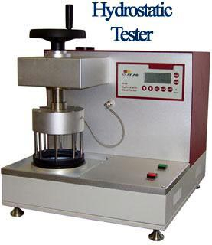
AATCC 127 - HYDROSTATIC PRESSURE TEST
Alternate test for polymeric materials (AC38 and ASTM E2556)
Measures pressure at which water is forced through a material by observation
Resistance to liquid water usually varies inversely with water vapor permeance

Slide 17
CCMC - WATER PONDING TEST
Pass-fail test
Cylindrical bowl of sample filled with 1 inch of water for two hours.
Pass = no seepage observed below the sample

Slide 18
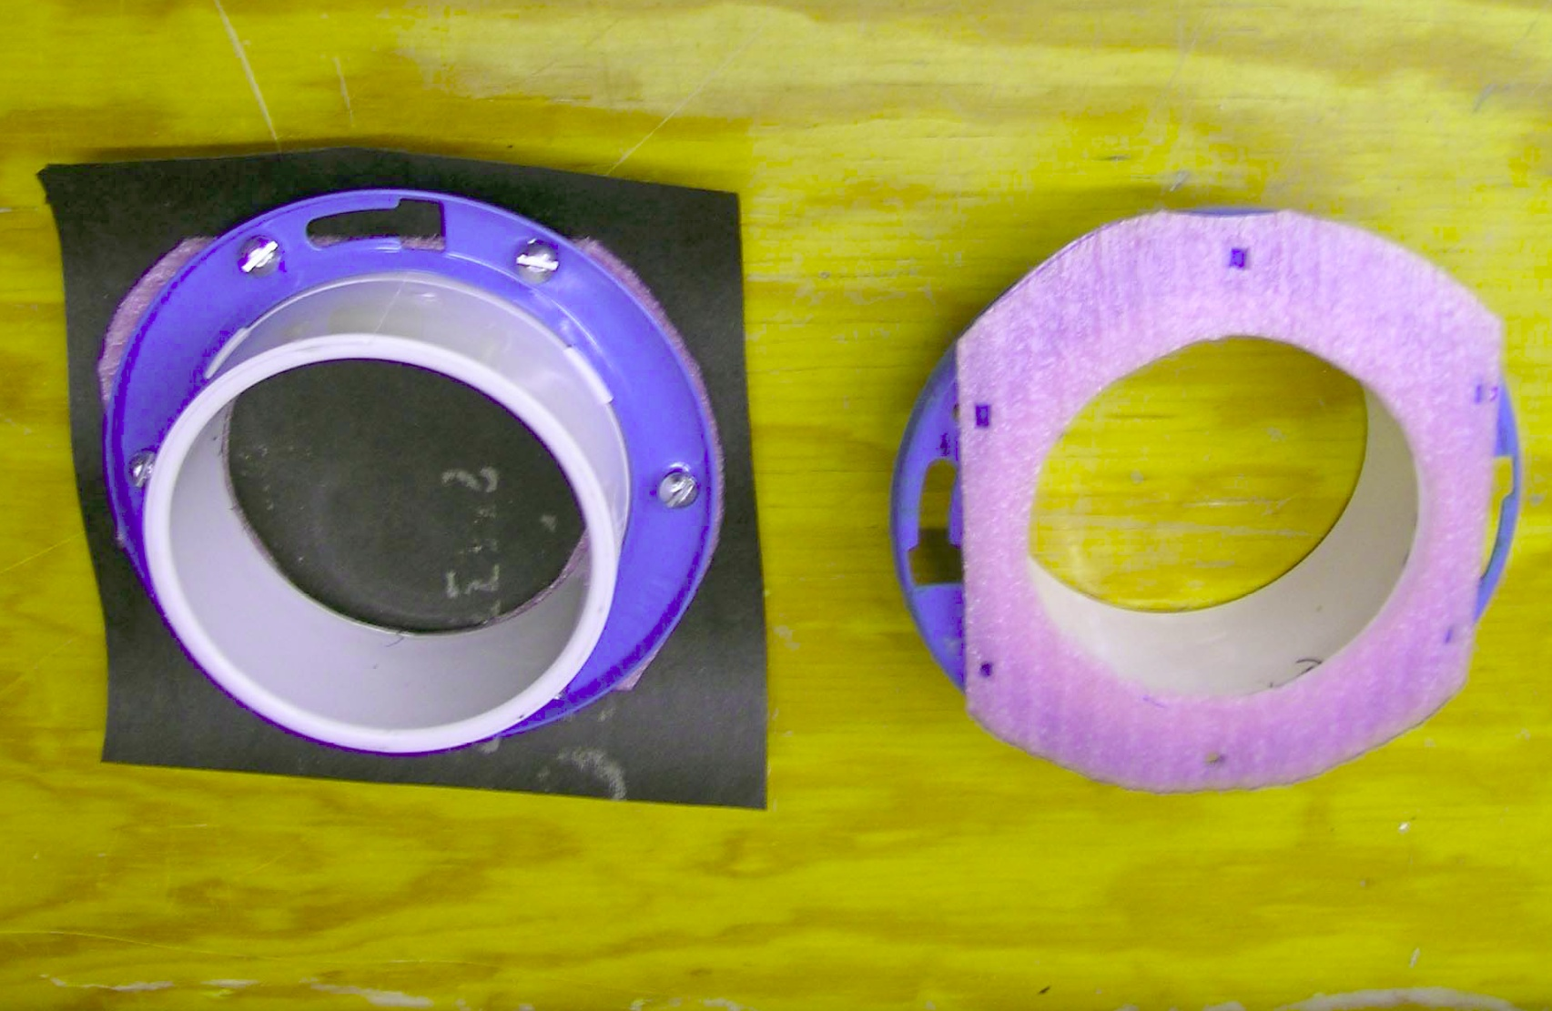
WATER PONDING TEST SETUP

Slide 19
COMPARABLE TYPICAL WATER RESISTANCE USING CODE REFERENCED TESTS

Slide 20
Water Resistance Under Pressure (AATCC Method 127)
C20 Window and C40 Window – too low to register

Slide 21
WATER RESISTANCE UNDER PRESSURE (AATCC METHOD 127)

Slide 22
CODE REQUIREMENTS FOR PERMEANCE
IBC: >10 perms
IRC: >5 perms (same as ASTM D2256)
NBCC: New: perms > 170 ng/(Pa·s m²) and < 1400 ng/(Pa·s m²) and Aged: > 2900 ng/(Pa·s m²)

Slide 23
VAPOR PERMEANCE - ASTM E96 –TEST METHODS FOR WATER VAPOR TRANSMISSION OF MATERIALS
Two basic methods (desiccant and water) and six variations (procedures A, B, BW, C, D and E)
“A permeance value obtained under one set of test conditions may not indicate the value under a different set of conditions.” (E96)

Slide 24
E96 VAPOR TRANSMISSION TERMS
Permeance (g/Pa·s·m²) is the accepted measure of vapor transmission of a building component acting as a vapor retarder.
Both AC38 uses water vapor transmission (WVT) g/m² *24h and ASTM E2556 uses perms
NBCC uses permeance
Without additional information, permeance cannot be converted to WVT, or vice-versa

Slide 25
PUBLISHED TYPICAL PERMEANCE VALUES
Asphalt Saturated Felt (Treschel):
  5.6 perms using E96 Desiccant Method
  1.0 perms using E96 Water Method
  “Breather Type Sheathing Paper” (building paper) CHMC Wood Frame Envelopes in Coastal Climate of British Columbia:
  2.96 to 24.39 perms

Slide 26
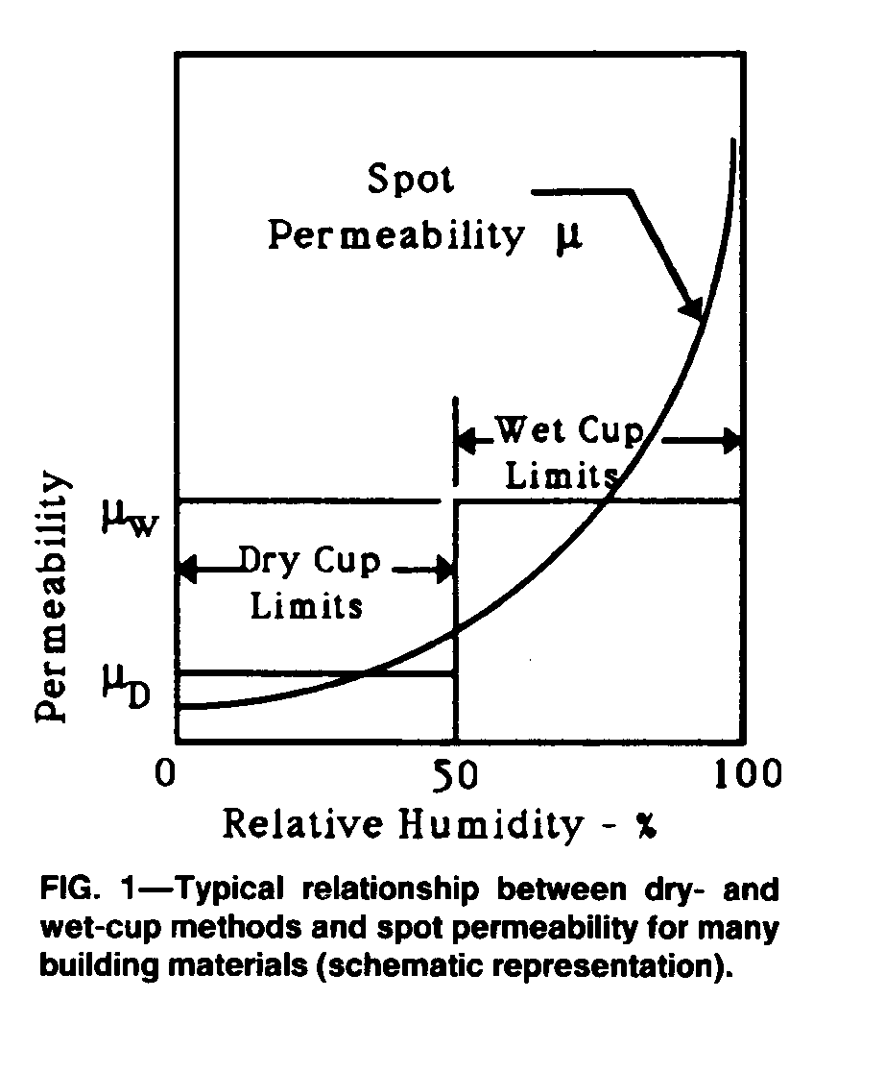
Challenge of a Hypothetical Service Condition
Permeance varies With humidity, temperature, vapor pressure and moisture content
Ronald P. Tye, "Relevant Moisture Properties of Building Construction Materials," Moisture Control in Buildings, ed., Heinz R. Trechsel (Philadelphia: American Society for Testing and Materials, 1994) 41-46

Slide 27
TYPES OF FLEXIBLE SHEET WRBS
Asphalt saturated organic felt
Asphalt saturated kraft paper
Polymeric Fabrics (polyolefin fibers or extruded polyethylene films)
  •Spun-bonded
  •Coated spun-bonded
  •Perforated cross laminated

Slide 28
SHEET WRB STANDARDS
AC38 - Water-resistive Barriers
ASTM E2556 - Standard Speciﬁcation for Vapor Permeable Flexible Sheet Water-Resistive Barriers Intended for Mechanical Attachment (ICC Chapter 25 in 2015 edition)

Slide 29
Water Vapor Permeance of Building Paper and Felt

Slide 30
“Permeance” of Polymer WRBs
Courtesy Fortifiber

Slide 31
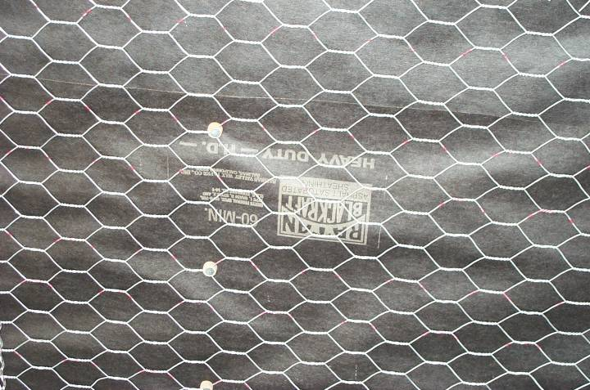
Asphalt Saturated Kraft Paper
200X

Slide 32
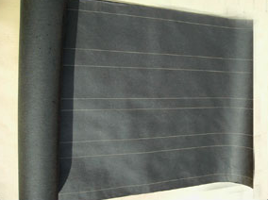
Asphalt Saturated Felt

Slide 33
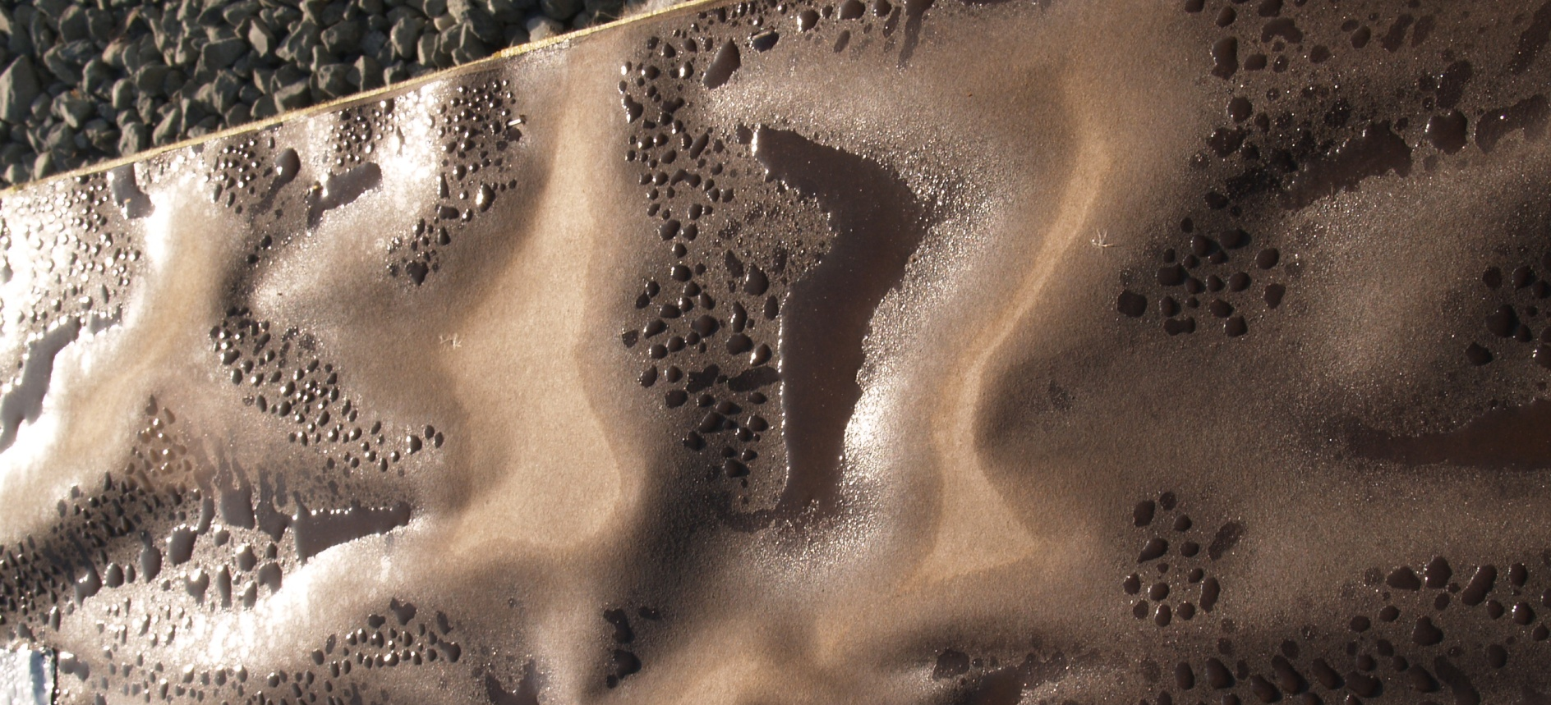
Building paper wrinkles when it absorbs water

Slide 34
Potential Advantages of Asphalt Saturated Felt
Long history of successful use under normal exposure conditions
Conforms prescriptively to most codes
Low material cost
Long-term durability may be superior to paper-based WRBs (more asphalt)
Best “boat test” performance
Comparatively high permeance may promote drying in wall cavity

Slide 35
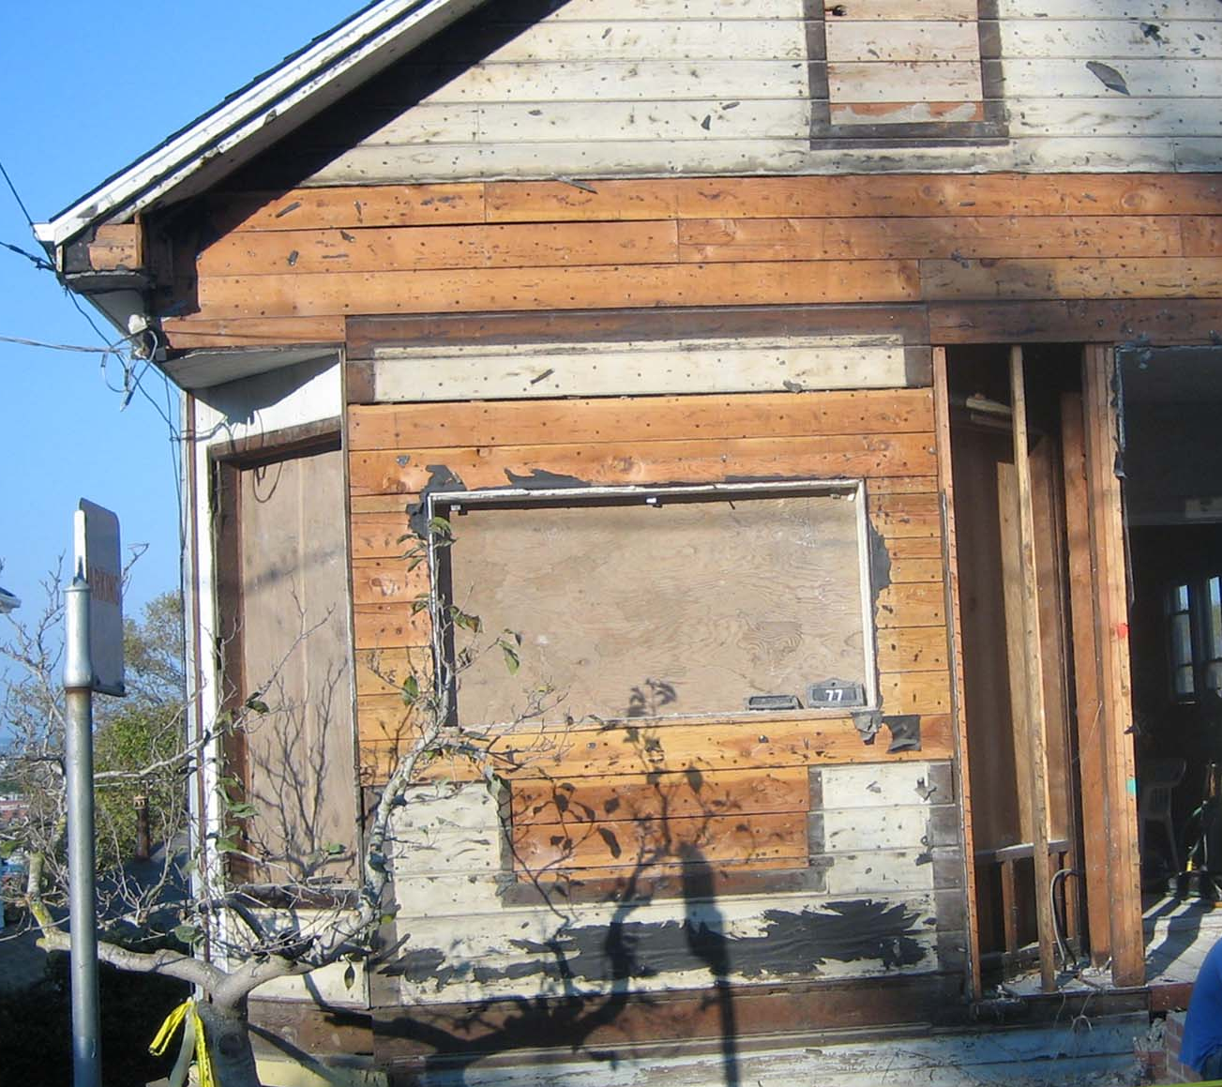
Durability of Asphalt Saturated Felt
Stucco removed after 45 years
#15 felt was intact and in good condition
All wood was dry and undamaged

Slide 36
Potential Disadvantages of Asphalt Saturated Felt
Minimal performance data available for use as WRB
Comparatively high permeance may result in moisture transport into wall cavity
Low resistance to breaking and tearing
Vulnerable to deterioration after long-term exposure to water, especially when combined with UV
Surfactant exposure may degrade water resistance

Slide 37
Potential Advantages of Asphalt Saturated Kraft Paper
Long history of successful use under normal exposure conditions
Prescriptively conforms to most codes
Low material cost
More performance data available than for felt
Better resistance to bending damage than felt, but tears easily
Comparatively lower permeance may result in less moisture transport into wall cavity

Slide 38
Potential Disadvantages of Asphalt Saturated Kraft Paper
Low resistance to tearing
Decomposes after long-term exposure to water, especially when combined with UV
Surfactant exposure may degrade water resistance
Less asphalt compared to felt-based WRBs
Comparatively lower permeance may retard drying in wall cavity

Slide 39
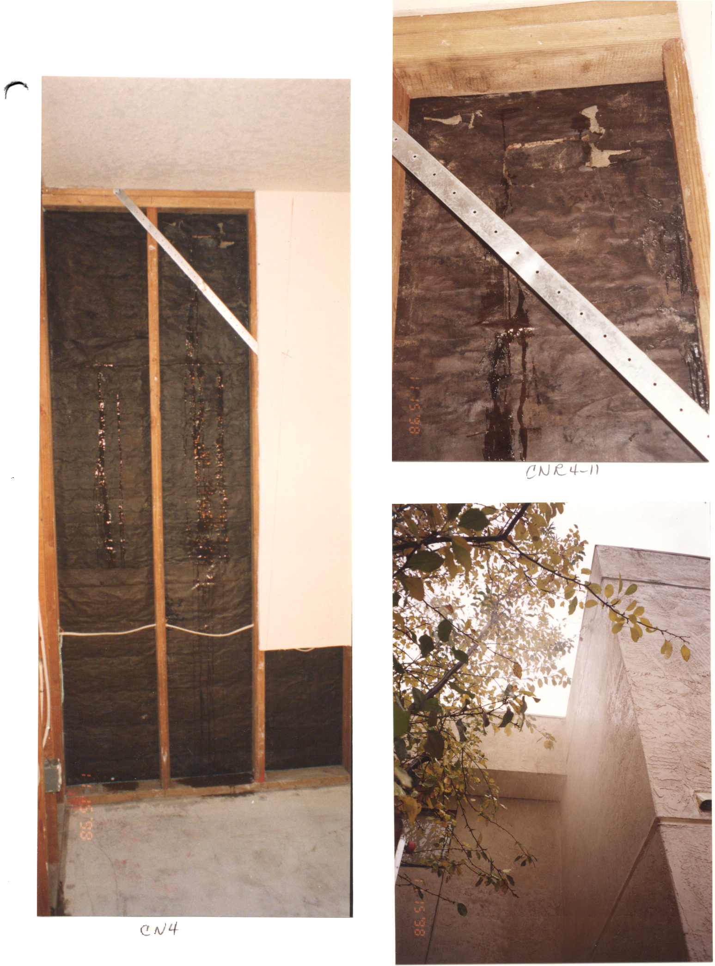
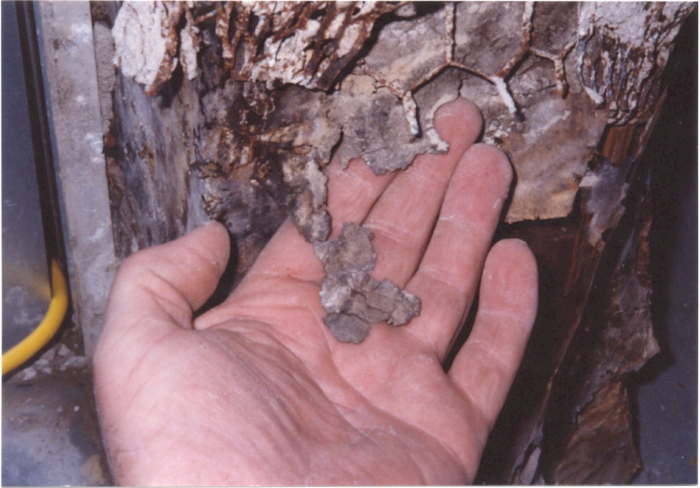
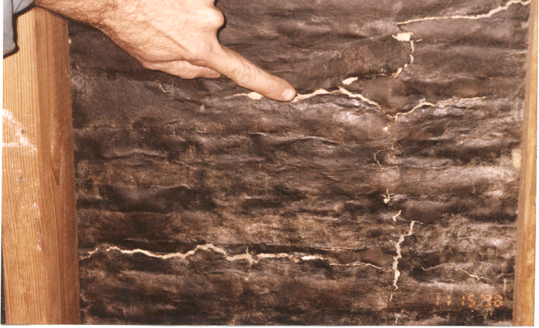
Building paper can erode from repeated wetting leading to leakage

Slide 40
Potential Advantages of Polymeric Sheets
High resistance to tearing and breaking
Large sheets with fewer lap joints
Remains durable after long-term water exposure
Air barrier functionality
High water vapor permeance allows drying by evaporation of wall cavity
High resistance to water under pressure

Slide 41
Potential Disadvantages of Polymeric Sheets
Relatively expensive material cost
UV sensitivity
Sensitivity to surfactants
Adhesion to cement plaster (stucco) may affect water resistance
Comparatively high permeance may result in moisture transport into wall cavity
May retain liquid water in wall cavities

Slide 42
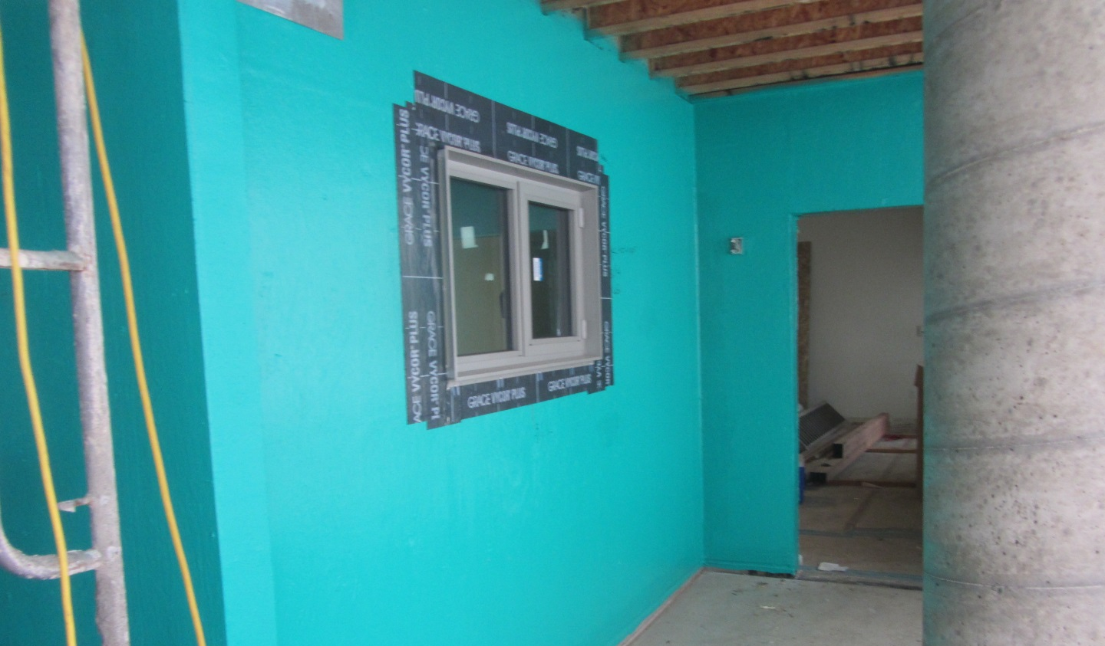
LIQUID APPLIED WRB

Slide 43
LIQUID APPLIED WRB STANDARDS
AC209 - Trowel-, Spray- or Roller-applied Water-resistive Coatings Used as Weather-resistive Barriers over Exterior Cementitious Wall Coverings
ASTM E2570 – Standard Test Methods for Evaluating Water Resistive Barrier (WRB) Coatings Used under Exterior Insulation and Finish Systems (Now in ICC, replaces AC212)

Slide 44
LIQUID APPLIED WRBs
AC 209 - Trowel-, Spray- or Roller-applied Water-resistive Coatings Used as Weather-resistive Barriers over Exterior Cementitious Wall Coverings and AC212 - Water-resistive Coatings Used as Water-resistive Barriers over Exterior Sheathing
Refers to AC 38 for Water vapor Permeance
Refers to AC 38 and ASTM E331
  AC 209: 6.24 PSF for 75 minutes
  AC 212: 2.86 PSF for 15 minutes

Slide 45
RIGID BOARD WRB STANDARD
AC71 - Foam Plastic Sheathing Panels Used as Weather-resistive Barriers
  Water Resistance: AATCC Test Method 127, 55 cm for 5 hours and ASTM E331 at 6.24 PSF for 2 hours
AC382 - Laminated Fibrous Board Sheathing Material Used as a Water-resistive Barrier
  Water Resistance: ASTM E331 2.86 PSF for 15 minutes and Hydrostatic Pressure Test, 550 mm for 5 hours

Slide 46
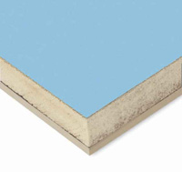
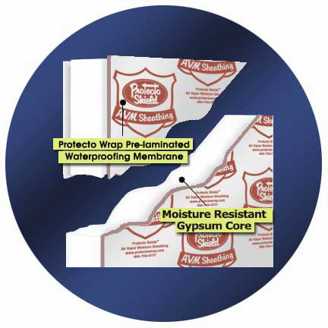
Board Products
Board products (i.e., foam core board)

Slide 47
DEFINITION – AIR BARRIER
International Energy Conservation Code (IECC): Material(s) assembled and joined together to provide a barrier to air leakage through the building envelope. And air barrier may be a single material or a combination of materials.
Typical Standard: 0.004 cfm/ft², under a pressure differential of 0.3 in. w.g. (1.57 psf) (0.02L/m² at 75 Pa), when tested in accordance with ASTM E2178.

Slide 48
AIR BARRIER STANDARDS
ASTM E283-04(2012) Standard Test Method for Determining Rate of Air Leakage Through Exterior Windows, Curtain Walls, and Doors Under Specified Pressure Differences Across the Specimen
ASTM E2178-13 Standard Test Method for Air Permeance of Building Materials
ASTM E2357-11 Standard Test Method for Determining Air Leakage of Air Barrier Assemblies
ASTM E1677-11 Standard Specification for Air Barrier (AB) Material or System for Low-Rise Framed Building Walls
ASTM E1680-11 Standard Test Method for Rate of Air Leakage Through Exterior Metal Roof Panel Systems
WK16958 - New Specification for Fluid-Applied Air Barrier Materials

Slide 49
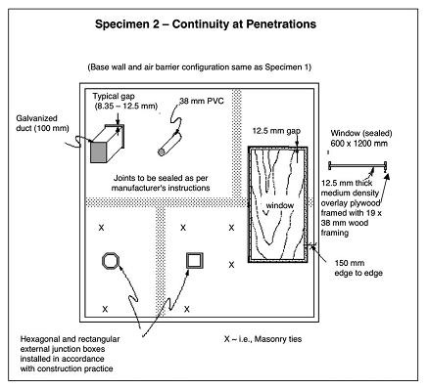
ASTM E2357 – TEST APPARATUS

Slide 50
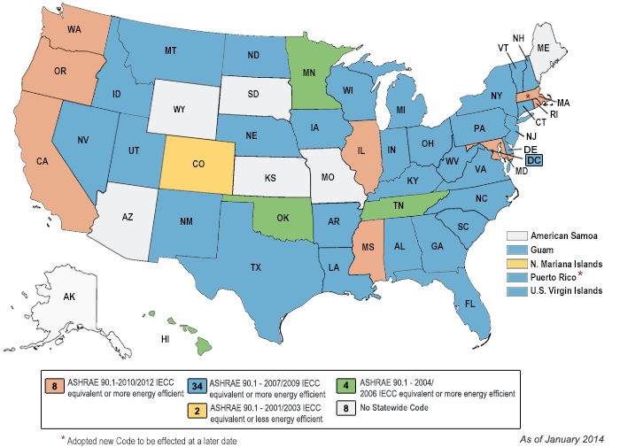
COMMERCIAL ENERGY CODE ADOPTION STATUS

Slide 51
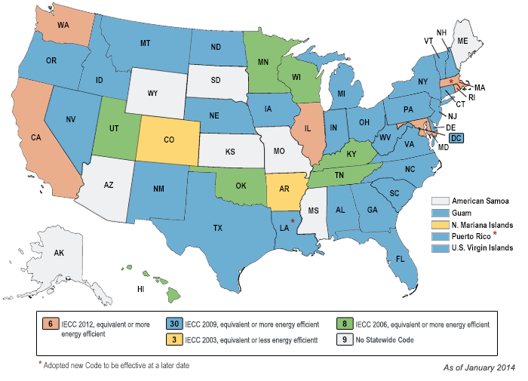
RESIDENTIAL ENERGY CODE ADOPTION STATUS

Slide 52
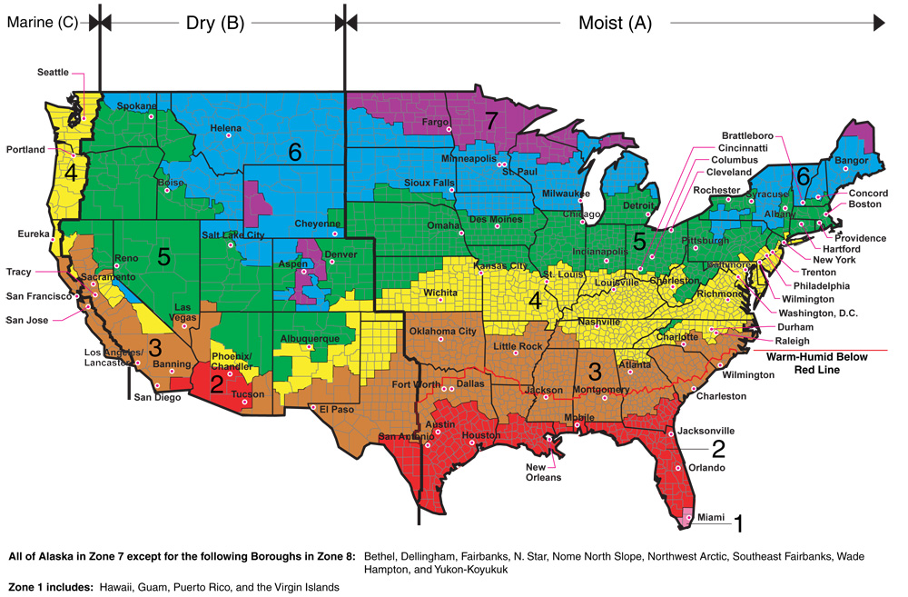
AIR BARRIERS REQUIRED IN ZONE 4 AND HIGHER

Slide 53
CALIFORNIA CODE EXCEPTIONS for AIR BARRIERS
Plywood – min 3/8 inch thickness.
Oriented strand board – min. 3/8 inch thickness.
Extruded polystyrene insulation board – min. ½ inch thickness.
Foil-back polyisocyanurate insulation board – min. ½ inch thickness.
Closed cell spray foam with a minimum density of 2.0 pcf and a min. 2.0 inch thickness.
Open sell spray foam with a density of no less than 0.4 pcf and no greater than 1.5 pcf, and a min. 5 ½ inch thickness.
Exterior or interior gypsum board min. ½ inch thickness.
Cement board – min. ½ inch thickness.
Built up roofing membrane.
Modified bitumen roofing membrane.
Fully adhered single ply roofing membrane.
A Portland cement or Portland sand parge, or a gypsum
Fully grouted concrete block masonry
Sheet steel or sheet aluminum.

Slide 54
DEFINITION - VAPOR RETARDER
IRC: A measure of the ability of a material or assembly to limit the amount of moisture that can pass through the material or assembly. Vapor retarder class shall be defined using the dessicant method with Procedure A of ASTM E96

Slide 55
VAPOR RETARDER CLASSES
Class I: 0.1 perm or less (sheet polyethylene, non-peforated aluminum foil)
Class II: 0.1 < perm < 1.0 perm (kraft-faced fiberglass batts)
Class III: 1.0 < perm < 10 perm (latex or enamel paint)

Slide 56
IBC VAPOR RETARDER REQUIREMENTS
Class I or II on interior side in Zones 5, 6, 7 8 and Marine 4
Class II allowed in various conditions depending on ventilation and insulation type.

Slide 57
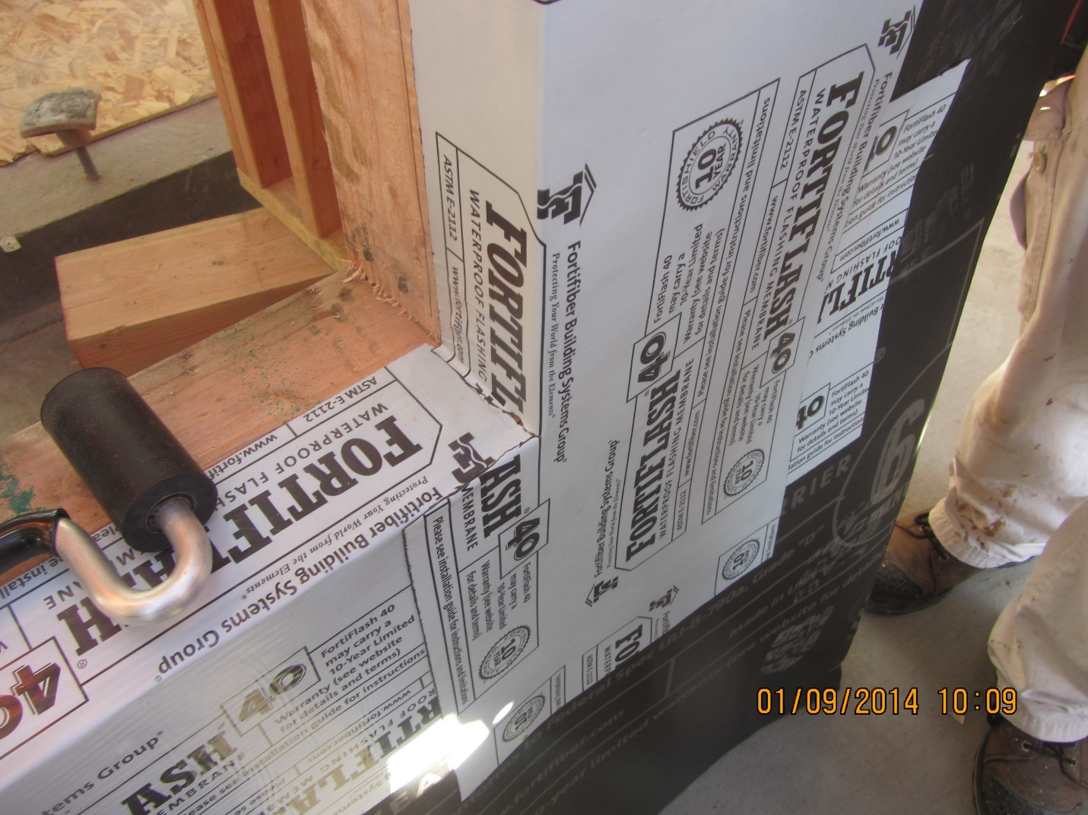
FLEXIBLE FLASHINGS

Slide 58
FLASHING
Typically not defined in codes
AC148 Definition - Flashing: Sheet material, integrated with the water-resistive barrier that bridges and protects the joint (gap) between the window or door frame members and the adjacent construction for the purpose of preventing water penetration by draining water away from the window or door

Slide 59
FLASHING – ASTM DEFINITIONS
Flashing (ASTM E 2266) - a component or system typically composed of sheet material that is employed at interfaces between building components for the purpose of diverting water directly to the exterior or onto the weather-resistive barrier.
Flashing (ASTM E 2112) - sheet material that bridges and protects the joint (gap) between the window or door frame members and the adjacent construction for the purpose of preventing water penetration by draining water away from the window or door to the exterior. For further discussion, see Appendix

Slide 60
TYPES OF FLASHINGS – AC 148 DEFINITIONS
Self-Adhering Flashing - Flashing consisting of flexible facing materials coated completely or partially on at least one side with an adhesive material and which do not depend on mechanical fasteners for permanent attachment.
Mechanically Fastened Flashings – Flexible facing materials which depend on mechanical fasteners for permanent attachment

Slide 61
Definition - Self Adhering Flashings
(AAMA 711)
Self Adhering Flashings - Flexible facing materials coated completely or partially on at least one side with an adhesive material and which do not depend on mechanical fasteners for permanent attachment. They are used to bridge the joint (gap) between fenestration framing members and the adjacent weather resistive barriers or sealed drainage plane material. The purpose of flashing is to drain water away from the fenestration product to the exterior. Self Adhering Flashings typically are currently sold in widths such as 4”, 6”, 9” etc. and come in a rolled form and have a release liner that is removed prior to application.

Slide 62
AAMA 711 FLEXIBLE FLASHING TYPES
Type A Products: Products that pass this specification without the use of a primer.
Type A Products: Products that pass this specification without the use of a primer.
  Level 1: For exposures up to 50º C (122ºF)
  Level 1: For exposures up to 65º C (149ºF)
  Level 1: For exposures up to 80º C (176ºF)

Slide 63

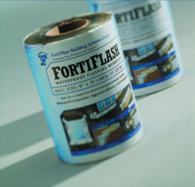
Self Adhering Flashings – Classes (AAMA 711)
Level 1: For exposures up to 50°C (122°F)
Level 2: For exposures up to 65°C (149°F)

Slide 64
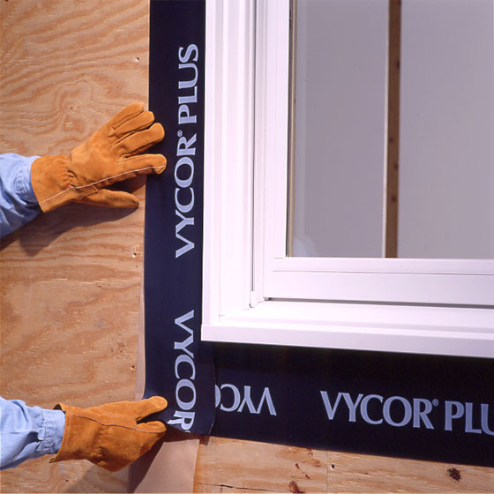
Self Adhering Flashings – Classes (AAMA 711)
Level 3: For exposures up to 80°C (176° F)

Slide 65
FLEXIBLE FLASHING STANDARDS
AC148 Flexible Flashing Materials
AAMA 711 - Voluntary Specification for Self Adhering Flashing Used for Installation of Exterior Wall Fenestration Products
ASTM D1970 - Standard Specification for Self-Adhering Polymer Modified Bituminous Sheet Materials Used as Steep Roofing Underlayment for Ice Dam Protection

Slide 66
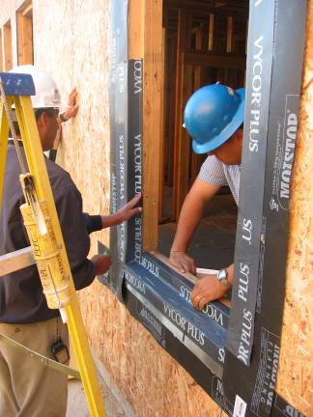
WRB/Flashing Interface Regional Differences
Felt and paper: Flashing prior to WRB installation (western U.S.)
Polymer: Flashing after WRB installation (eastern U.S.)

Slide 67
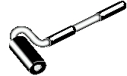

Rolling the Flashing
Roller tools made for plastic laminate and wallpaper can be used to apply pressure to flexible flashings to avoid wrinkles ad achieve good adhesion. These are available from:
Beno J. Gundlach Company
211 North 21st Street • PO Box 544 • Belleville, IL • 62222 • USA

Slide 68
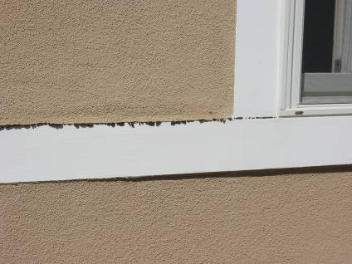
Adhesives
Butyl versus modified bitumen
Sealant versus adhesive
Primers
Temperature range
Surface condition
Tooling and rolling
Adhesive Flow

Slide 69
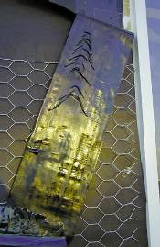
Adhesive Migration
Adhesive melting in 80º F heat in Sacramento

Slide 70
Adhesion Challenges

Slide 71
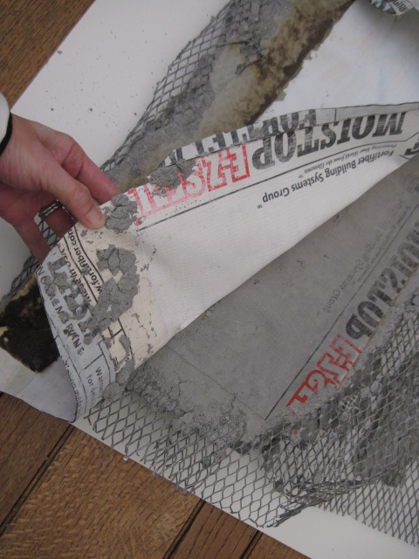
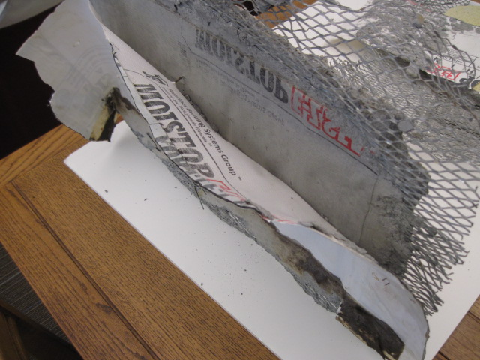
Stucco Bond Breakers at Plastic Flashing?
Plaster adheres to flashing, blocking drainage and resulting in leaks

Slide 72
CONCLUSIONS
Complexity of complying with codes and standards and finding the optimum solution for building envelope thermal insulation, air resistance, water resistance and vapor permeance is beyond the capability of most building professionals.
I hope this helps

Slide 73
Questions?
Tom Butt, FAIA
Interactive Resources
510/236-7435
Tom.butt@intres.com

